Slide 1
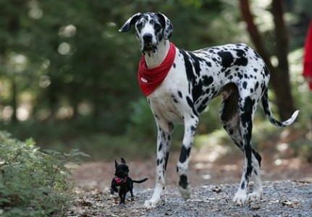
BODY SIZE : Patterns

Slide 2
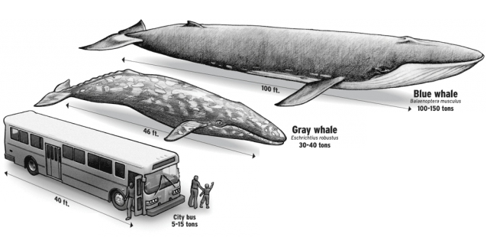
Why a species has the body size it does?
Optimum trade-off
Cost
Ecological /
Evolutionary
forces
Benefit
Body size

Slide 3
Body size
Resources
Interactions: predation, competition
Determinants
Spatial
temporal variations
PATTERNS
Climate
Human driven evolution

Slide 4

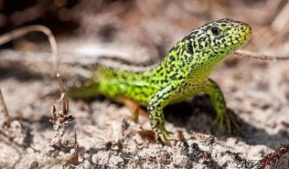
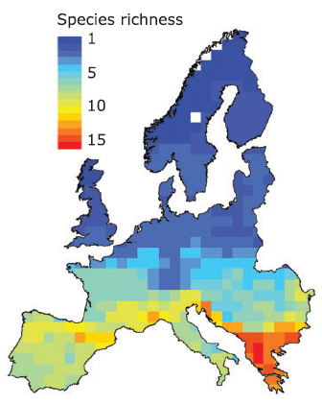
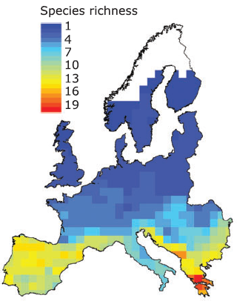
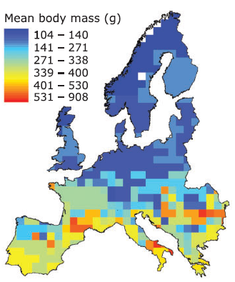
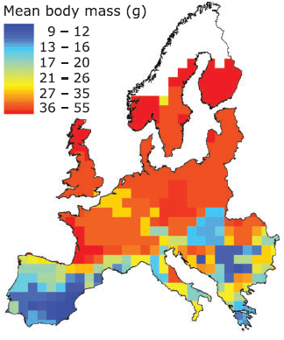
Contrasting associations with environmental gradients suggest that no single
mechanism can explain variations of body size
Olalla-Tarraga et al, J. Biogeo. (2006)

Slide 5
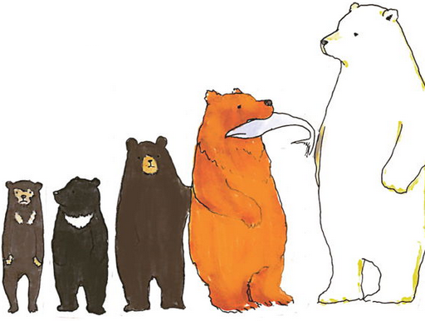
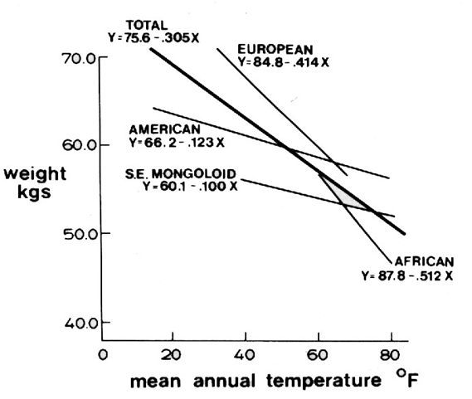
Geographical variations in body size: Bergmann's rule
Body size increases with colder temperatures
2
Mass=8
Area=24
Area/Mass=3
2
2
A lower area/mass ratio helps to conserve heat which is very adaptable in cool temperature
A higher area/mass ratio helps to dissipate heat which is very adaptable in warm temperature
Roberts DF (1978) Climate and human variability
1
Mass=1
Area=6
Area/Mass=6
1
1

Slide 6


Geographical variations in body size: Allen's rule
Limbs and other appendices are shorter and more compact in individuals living in colder temperatures
The greater the exposed surface area, the greater the loss of heat and therefore energy
Mass=8
Area=24
Area/Mass=3
Will conserve more heat, which is better in colder environments
Will dissipate more heat, which is better in warmer environments
Mass=8
Area=28
Area/Mass=3.5

Slide 7
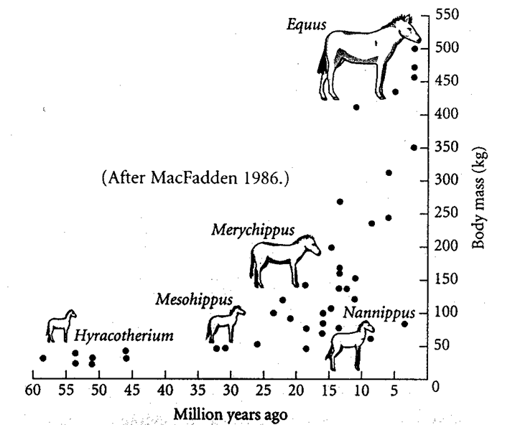
Geographical variations in body size: Cope's rule
Lineages tend to increase in body size over evolutionary time
Size benefits survival, mating success and fecundity (Hone & Benton, Trends Ecol. Evol. 2005)
Any contradiction with prior knowledge?

Slide 8
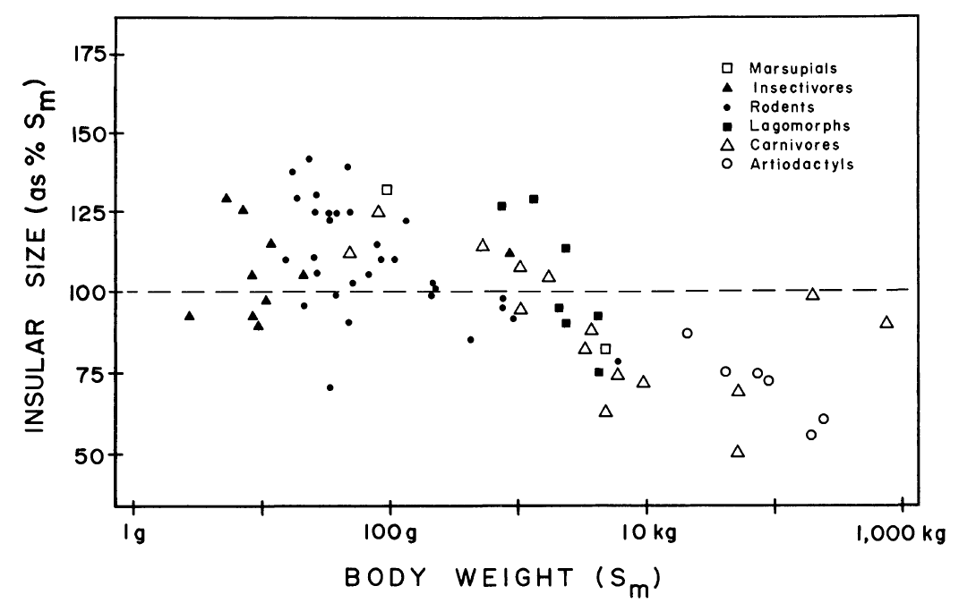
Geographical variations in body size: Island rule
Insular body size of terrestrial mammal as percentage of body size of the species on the mainland (Sm)
Small species get larger
Ecological release
Large species get smaller
Resource limitation
Any contradiction with prior knowledge?

Slide 9
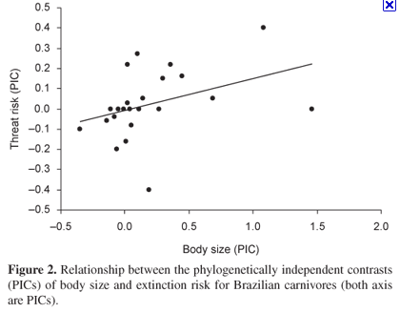
Why shall we care about patterns in body size?
Because body size influences the risk of becoming extinct
Forero et al., Biota Neotrop 2009

Slide 10
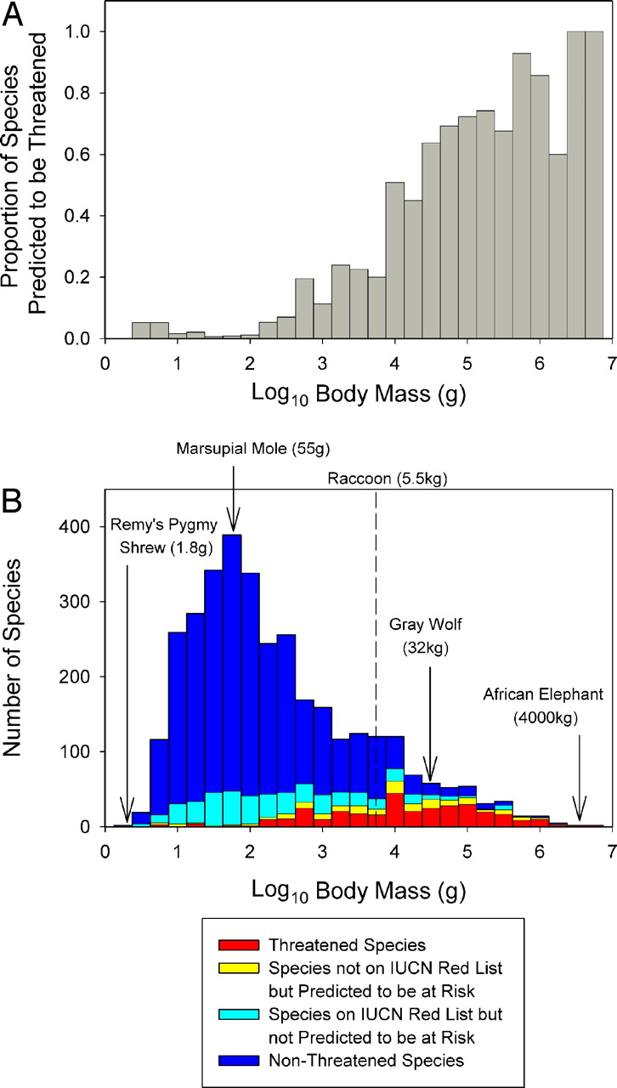
Why is this important
Mammalian body mass by current extinction risk
Davidson A D et al. PNAS 2009;106:10702-10705
Notes:
(A) Body size and extinction risk. Proportion of species predicted to be threatened in each body size class (0.25 log g). (B) Mammalian body mass distribution showing the 4 risk categories based on the random forest model.

Slide 11
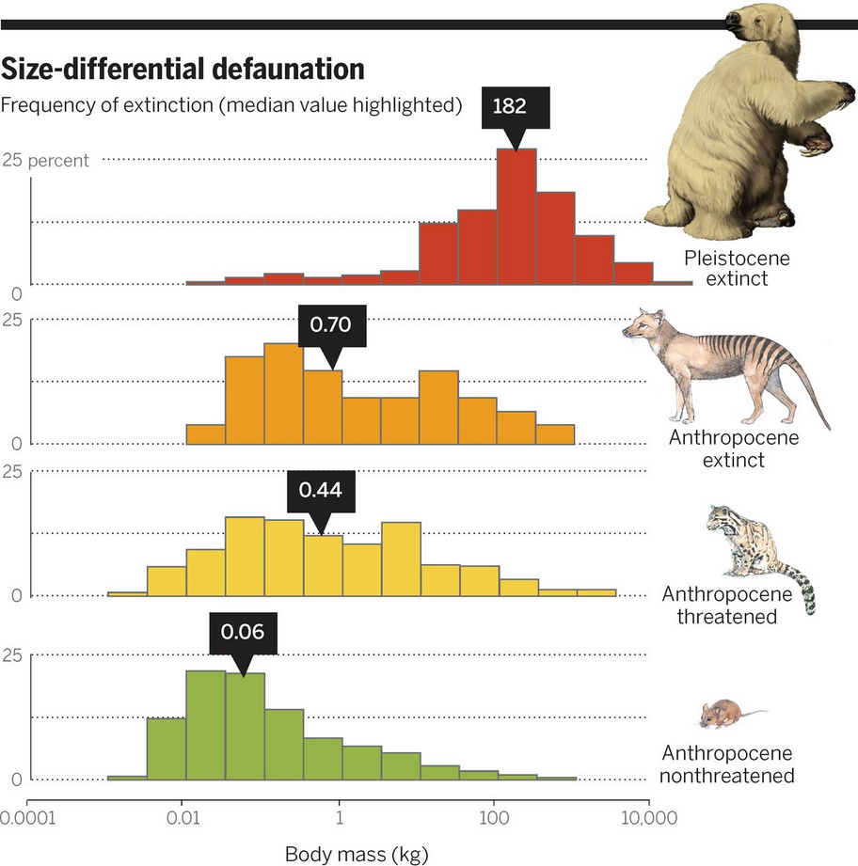
Why is this important: we are left with small species
Dirzo et al. Science 2014

Slide 12
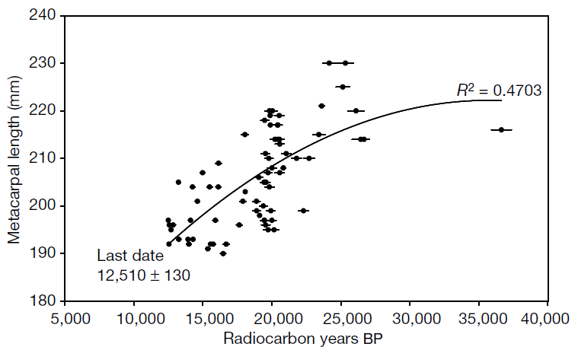

Why is this important
Rapid body size decline in Alaskan Pleistocene horses before extinction
Guthrie, Nature 2009
Current declines in body size are worrisome sings of extinction

Slide 13
In summary
Resources
Interactions: predation, competition
Determinants
Climate
Human driven evolution
Body size
Bergmann's rule: Body increase with latitude
Allen's rule: Limbs and other appendices get shorter in colder areas
Patterns
Cope's rule: Body increase with evolutionary time
Island rule: On islands large species get smaller and vice versa

